Slide 1
AI vs Non-AI: Cracking the Job Market Code in 2024
Business Running Case – Spring 2025
Team 4: Vidhi Sharma, Soham Deshkhaire, Nhan Huynh

Slide 2
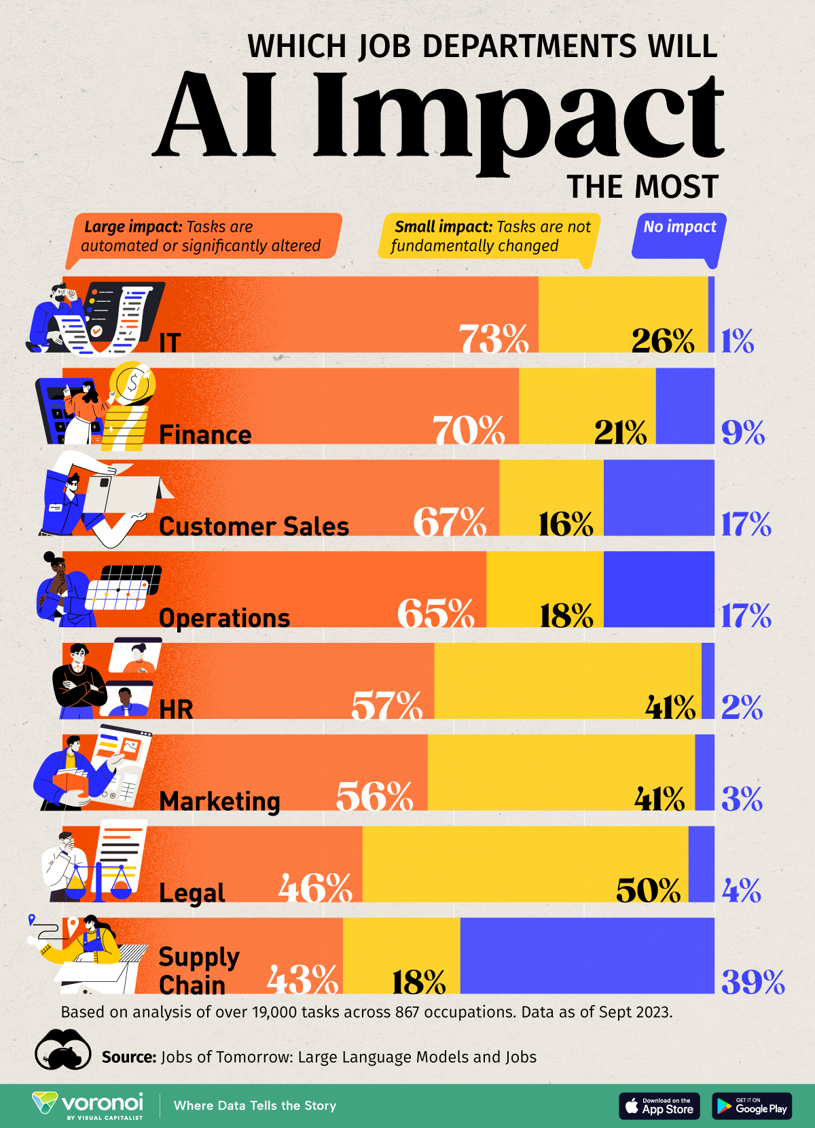
INTRODUCTION
AI is exploding — but what about Non-AI roles?
We explored the 2024 job market to answer:
Who’s hiring?
What skills matter most?
How do you stay competitive?

Slide 3
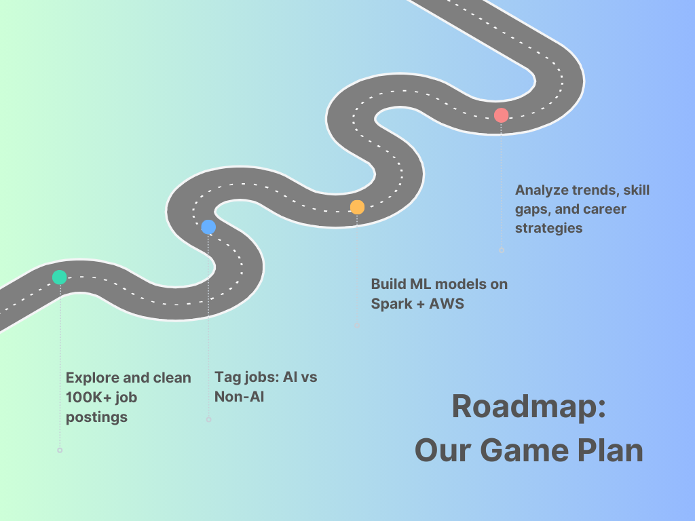

Slide 4
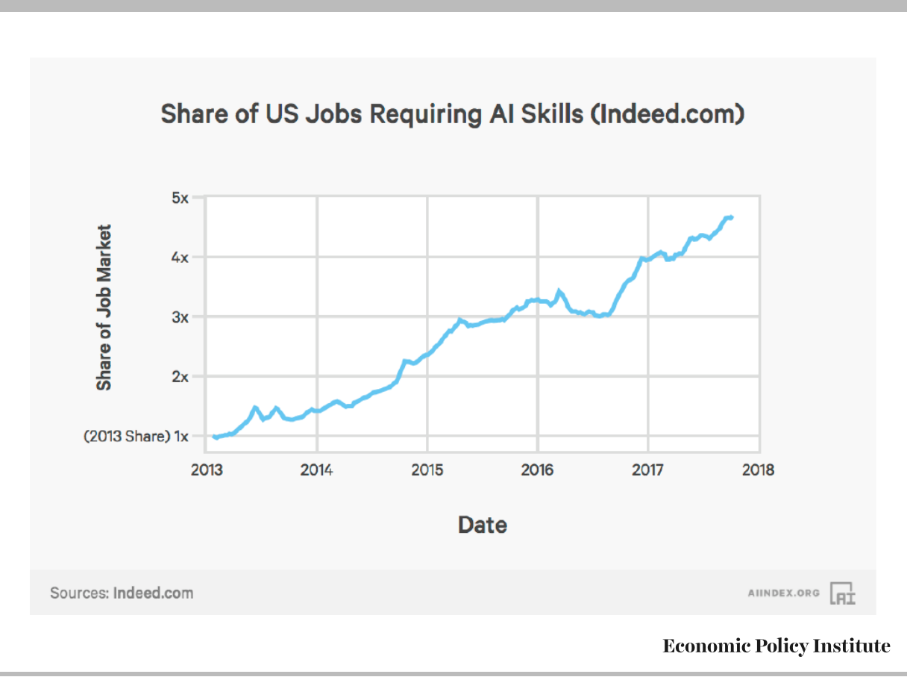
Dataset Overview
100,000+ US job postings (Jan–Mar 2024)
Features: Title, skills, description, salary
Manual tagging: AI roles vs Non-AI roles
Tools: TF-IDF, PySpark, AWS EC2

Slide 5
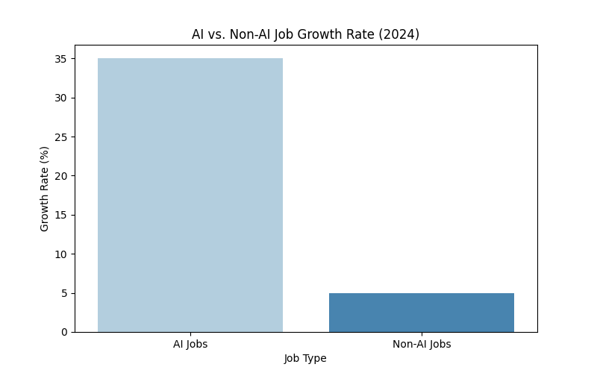
EDA Insights : What the Data Revealed
AI Jobs:
Top roles: ML Engineer, Data Scientist
Avg Salary: ~$118K
Non-AI Jobs:
Top roles: Project Manager, HR Coordinator
Avg Salary: ~$72K
Analysis of Lightcast 2024 job postings

Slide 6
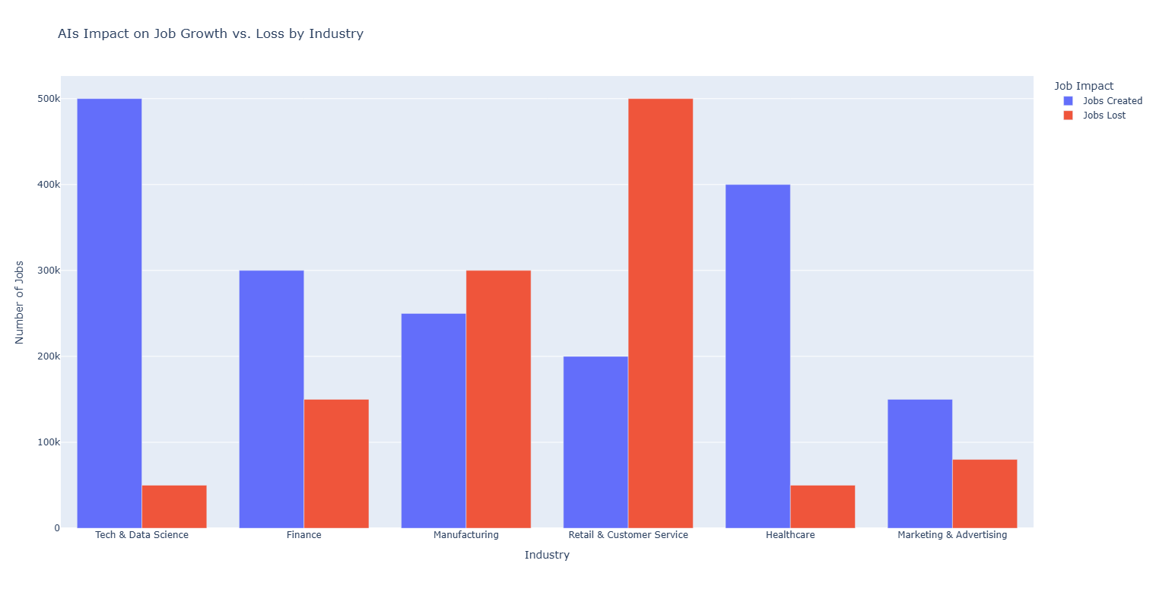
Skill Gap Analysis
Title: The Missing Skills Content (left AI, right Non-AI):
AI Track Missing:
Deployment skills (AWS, APIs)
MLOps knowledge
Non-AI Track Missing:
BI tools (PowerBI, Tableau)
AI prompt literacy

Slide 7
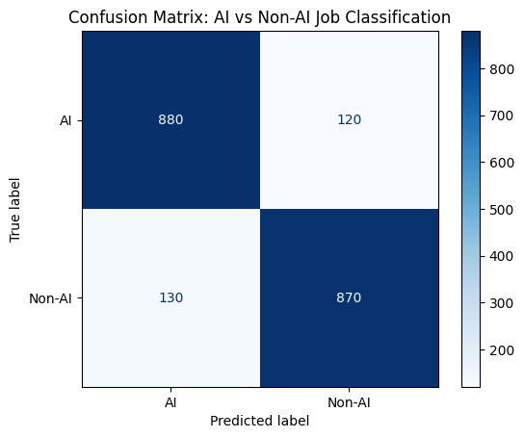
Modeling the Market: Predicting Job Type Using ML
Random Forest Classifier: 89% accuracy
Key indicators:
AI roles: "pipeline," "GPU," "TensorFlow"
Non-AI roles: "calendar management," "CRM"

Slide 8
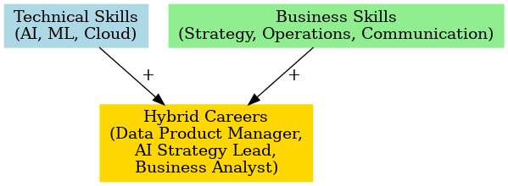
Hybrid Roles Discovery : Rise of Hybrid Jobs
Roles blending business + AI skills:
AI Strategy Lead
Data Product Manager
Low competition, high demand

Slide 9
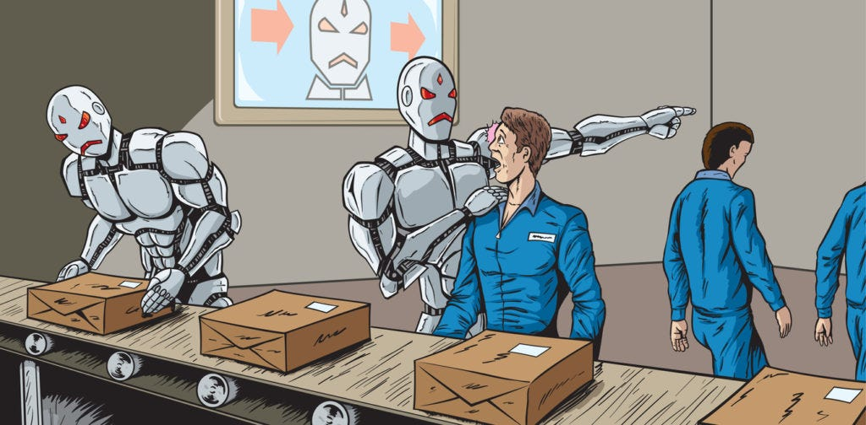
Career Advice : How to Future-Proof Your Career Split into 3 blocks:
AI Track: Projects > certificates, deploy work
Non-AI Track: Learn BI, use AI tools
Hybrid: Combine human + technical skills for the win

Slide 10

Challenges & Lessons
Real-World Data Lessons
Cleaning messy job titles = painful
AWS EC2 crashes = patience training
Git merge conflicts = team bonding exercise
Key lesson: Data science is 20% modeling, 80% chaos control

Slide 11
Team Member
Key Responsibilities
Vidhi Sharma
Led the machine learning model development, AWS Spark setup, authored major sections of the final report, and integrated EDA/modeling into the career strategy analysis.
Nhan Huynh
Handled comprehensive data preprocessing, conducted detailed skill gap analysis, contributed significantly to EDA findings, and supported final report refinement.
Soham Deshkhaire
Focused on creating exploratory data visualizations, formatting and polishing presentation slides, and maintaining GitHub repository structure and documentation.

Slide 12
THANK YOU AND FOR FINAL THOUGHT :
"AI won't replace you. But someone using AI smarter than you might.

